Slide 1
Tutorial 7
Prim’s algorithm and Bi-component (continued)

Slide 2
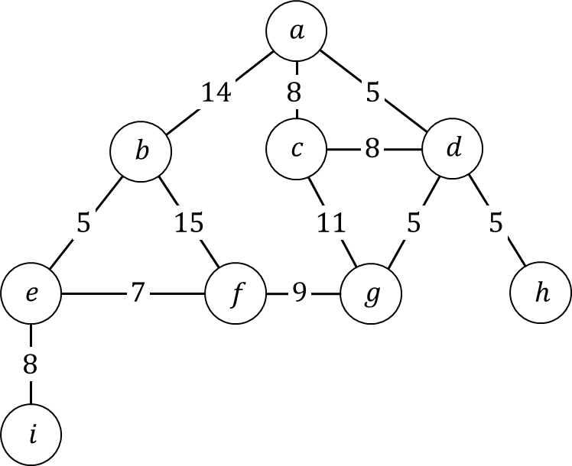
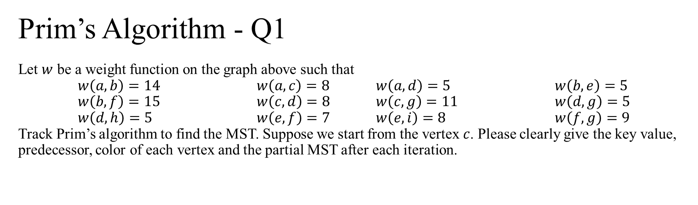
Prim’s Algorithm - Q1 Let $w$ be a weight function on the graph above such that $w\left(a,b\right)=14$ $w\left(a,c\right)=8$ $w\left(a,d\right)=5$ $w\left(b,e\right)=5$ $w\left(b,f\right)=15$ $w\left(c,d\right)=8$ $w\left(c,g\right)=11$ $w\left(d,g\right)=5$ $w\left(d,h\right)=5$ $w\left(e,f\right)=7$ $w\left(e,i\right)=8$ $w\left(f,g\right)=9$ Track Prim’s algorithm to find the MST. Suppose we start from the vertex $c$. Please clearly give the key value, predecessor, color of each vertex and the partial MST after each iteration.

Slide 3
Q2 – Compute Bi-Component (Tutorial 6 continued)
DFS Tree
F
G
A
(1,1)
I
A
B
K
C
B
(2,1)
I
D
(13,13)
H
(3,1)
E
C
D
G
M
(10,1)
(4,4)
(6,2)
J
E
F
H
J
(11,1)
L
M
(5,5)
(7,7)
(8,2)
(9,6)
K
L
(12,1)

Slide 4
Prim’s Algorithm – Q3
A
12
B
1
C
10
11
16
2
3
D
13
E
15
F
9
8
14
5
4
G
H
I
7
6
Suppose we start from the vertex A.

